Slide 1
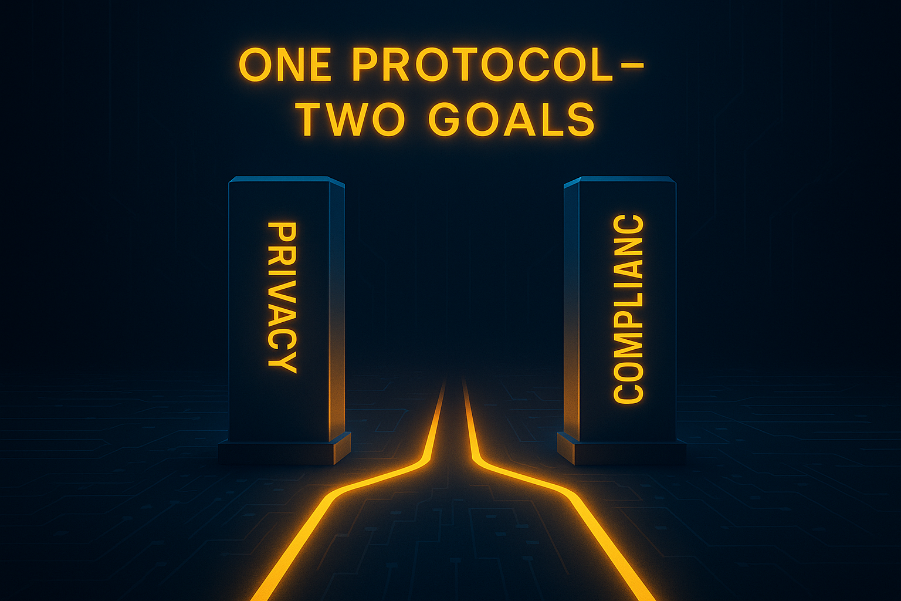
E
Legal Ledger Legends Archana, Patrick, Tijn, Sarah

Slide 2

The power of the blockchain: Trust Through Transparency — or at the Cost of It?
Transparency and trust
Security and Immutability
No Need for Intermediaries (Decentralization)
Efficiency and Speed
→ Transparency violates privacy. → Is a fully transparent system secure? → How do we regulate the system? → Can we regulate the system efficiently and fast?

Slide 3
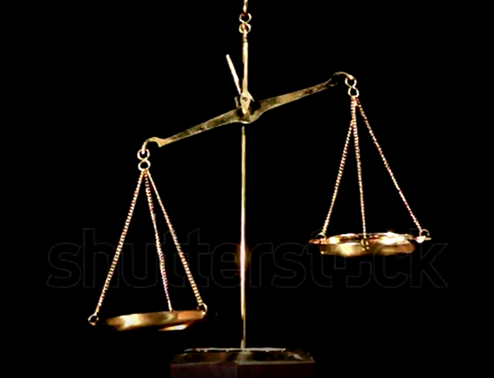
The solution?
Selective disclosure, but how?
Some issues:
If verifiers are compromised, biased, or corrupted, the system’s integrity collapses.
AI models make mistakes
People can have ulterior motives
A lot of false positives or false negatives.

Slide 4

Our solution: Three layered guardian system
First layer: decentralized monitoring issuing flags (Track 1)
Second layer: gatekeeping
Third layer: guardians get a warrant and check if it’s legit
They guard two things at once: AI-models and Fraud cases

Slide 5
First Layer: decentralized monitoring
AI-models/api’s (track 1)
Identity:
Model is executed in Trusted execution environment (TEE)
The model and the code are hashed to make sure it does not change
Objective:
Predict reason codes for transactions
Example reason codes:
Travel rule, KYC, money laundering, ..

Slide 6
Ensemble of models
What if an AI-model is corrupt?
AI-models work
together
If a model
reaches
<X% accuracy it gets removed
Not efficient models get deleted

Slide 7
second Layer: gatekeeping
Checks the validity of the requests
For every model accuracy is tracked
Identity checked: Confirm correct code + model
Verify that the quote was signed by the TEE
Compare the hash of the enclave to a known-good hash published by the model developer.
Verify the output signature
If confirmed, send to third layer
Notes:
If the model signs its output using an in-enclave private key, you can verify that the output wasn’t tampered with after inference.

Slide 8
Ensemble of models
What if an AI-model is corrupt?
AI-models work
together
TEE makes sure the models don’t change
If a model
reaches
<X% accuracy it gets removed
Not efficient models get deleted

Slide 9
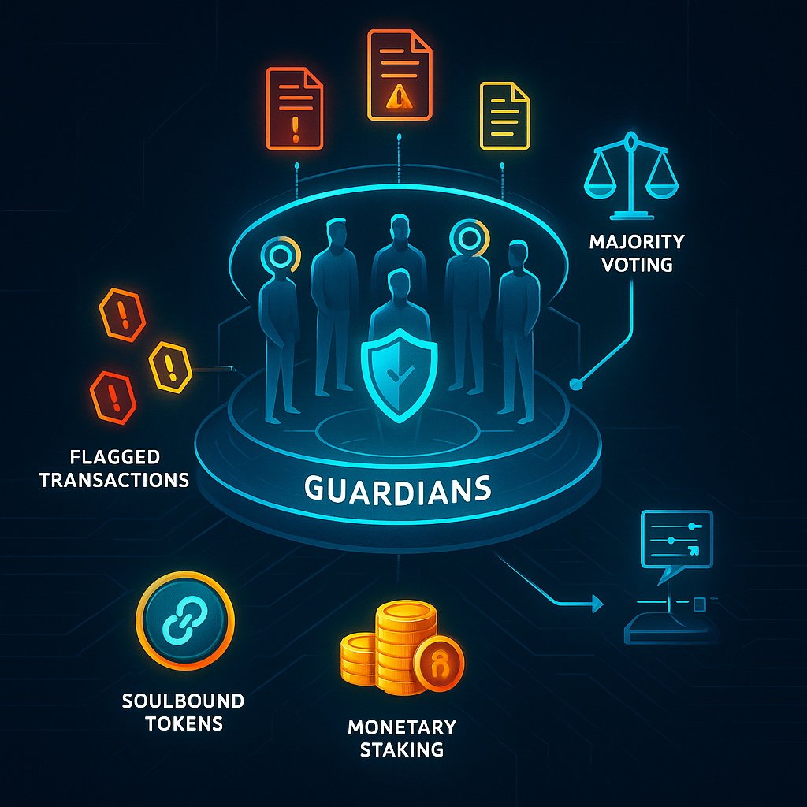
third Layer: guardians
Guardians checking reason codes
Final decision made using ⅔ majority voting.
https://guardian-protocol.vercel.app/dashboard/guardian

Slide 10

Incentives
Guardians (institutions):
Better ai models that detect fraud
SoulBound (reputation) tokens for organizations
Monetary value for individuals

Slide 11
Guardian Incentives
Identity & Reputation
KYC
Soulbound Reputation Token
Accountability
Stake
Performance
Rewards (uptime, good reputation)

Slide 12
revoker
Send final vote to second layer
Second layer updates accuracy of the models
Final vote decides if the privacy is revoked

Slide 13
accuracy demo (iteration 0)
acc=0
acc=0
acc=0
acc=0
Guardians (institutions)

Slide 14
accuracy demo (10 flags raised)
acc=2/5
acc=0
acc=3/3
acc=1/7
10 cases evaluated
Some were verified, some not
Guardians (institutions)

Slide 15
DEMO (100 flags raised)
acc= 18/30
acc= 1/2
acc= 30/48
acc= 1/20 (X)
100 cases evaluated
Some were verified, some not
A4 is not used anymore
Guardians build reputation
Models are evaluated on the go
Guardians (institutions)

Slide 16

Did we preserve the power of the blockchain
First layer: decentralized monitoring
Transparency and trust
Security and Immutability
No Need for Intermediaries (Decentralization)
Efficiency and Speed
→ Privacy by default ensures trust, but also transparency → The blockchain is still immutable, but more secure → Guarding is also decentralized → AI-models identify suspicious transactions, supervisors don’t have to assess all cases

Slide 17
Verifiers
How do we ensure verifiers are uncompromised, unbiased, or not corrupted?
3 step-verification
The first layer of AI-models monitors for reason codes
The second layer verifies if the input is trusted and not corrupt
The third layer has incentives to be truthful and reviews the output of the first layer

Slide 18
Thank you!
Any questions?
Legal Ledger Legends Archana, Patrick, Tijn, Sarah

